Slide 1
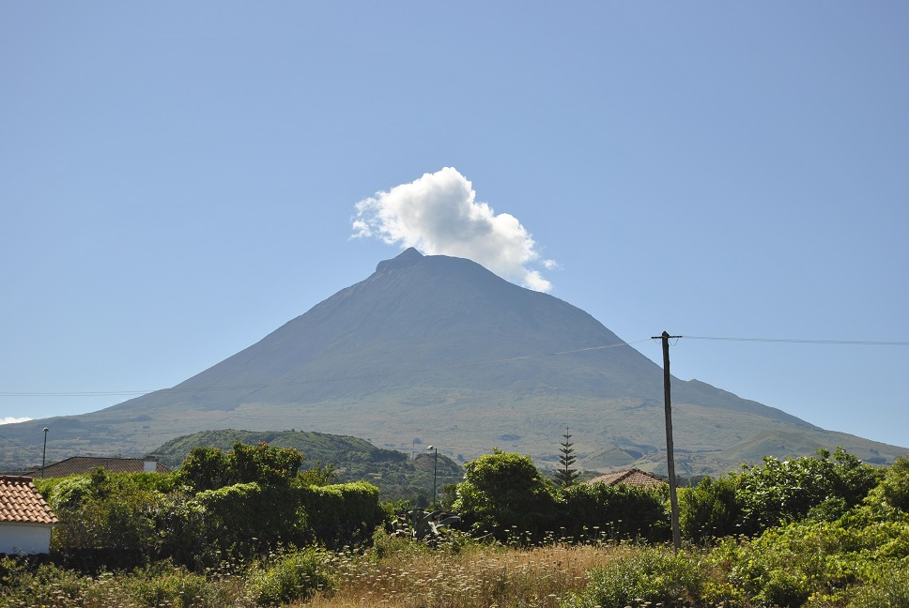
Pico Project
Effects of Aerosols on Climate
Photo: L. Harkness

Slide 2
Introduction
Aerosols can affect our climate, but how?
Several universities all over the world are researching this (Portugal, U.S., Germany…)
How are scientists conducting this research?
This is called the Pico Project, so why Pico?

Slide 3
Goals
Explain why Pico is an ideal location to study atmospheric aerosols
Define aerosols and classify them based on their structure
Identify the composition of aerosols reaching Mt. Pico
Determine the warming and/or cooling effects on the atmosphere by aerosols
Provide evidence and reasoning to the claim of aerosols affect climate
Relate classroom activities to real, on-going scientific research

Slide 4
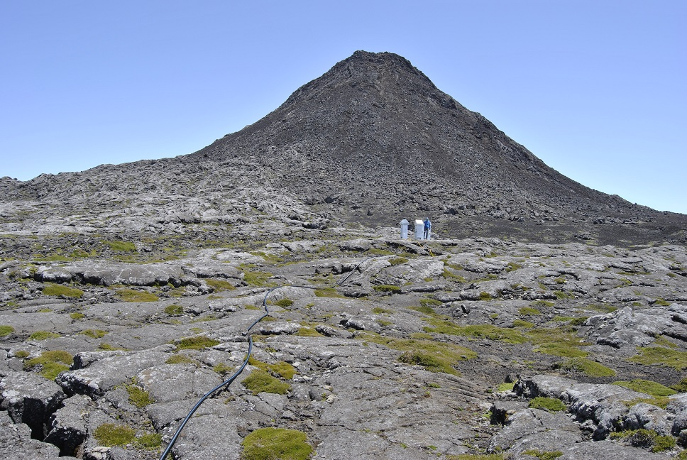
Purpose of Pico
Throughout the next several days, we will observe scientists completing research
You also will be participating in some of the same activities!
How scientists do science and research is important – it’s how we discover new things
Climate change is a real and relevant topic
Photo: L. Harkness

Slide 5
Your Task Today…
Research the questions on your handout
Find the answers you can and as much as you can
Sites to avoid: about.com, ask.com
Good sites: education sites
You will have 20 minutes!

Slide 6
Video Introduction
Click here for the video!

Slide 7
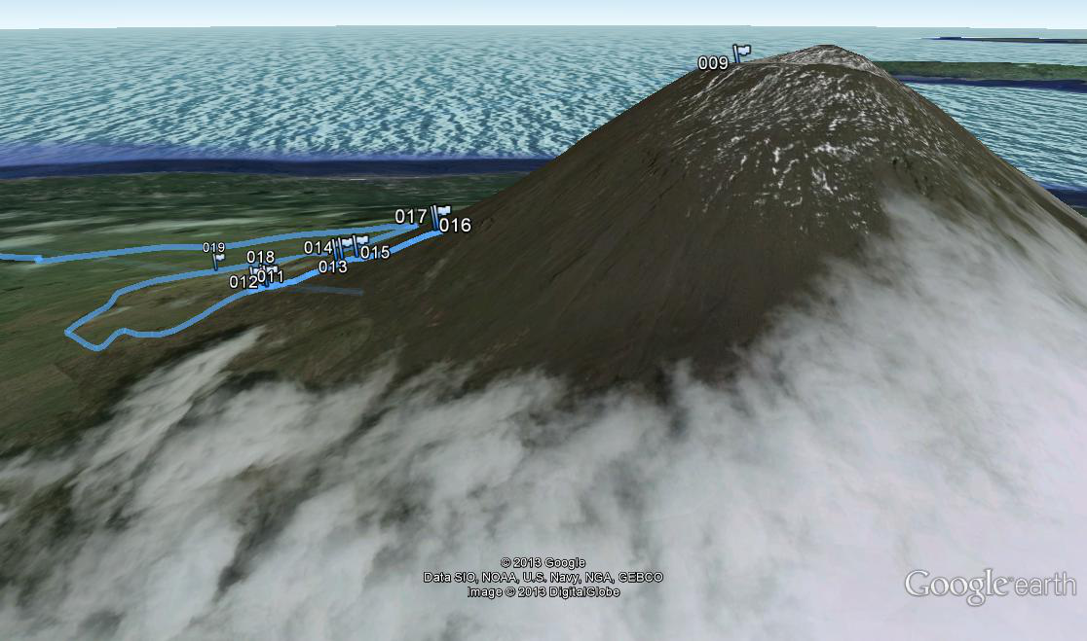
A portion of the hike up and down the mountain. Unfortunately, the weather turned and, for safety, we did not finish the climb that day. Waypoint 009 is the ICO, 011 is the Mountain House (where the climb begins) and 017 is were we turned back
N

